Slide 1
PROJECT CONTROL & PROCESS INSTRUMENTATION
By
Dr Cristin

Slide 2
Software metrics
Software metrics are used to implement the activities and products of the software development process. Hence, the quality of the software and the achievements in the development process can be determined using the software metrics.
Need for Software Metrics:
Software metrics are needed for calculating the cost and schedule of a software product with great accuracy.
Software metrics are required for making an accurate estimation of the progress.
The metrics are also required for understanding the quality of the software product

Slide 3
Software metrics
INDICATORS:
An indicator is a metric or a group of metrics that provides an understanding of the software process or software product or a software project. A software engineer assembles measures and produce metrics from which the indicators can be derived.
Two types of indicators are:
(i) Management indicators.
(ii) Quality indicators.

Slide 4
Software metrics
Management Indicators
The management indicators i.e., technical progress, financial status and staffing progress are used to determine whether a project is on budget and on schedule. The management indicators that indicate financial status are based on earned value system.
Quality Indicators
The quality indicators are based on the measurement of the changes occurred in software.

Slide 5
SEVEN CORE METRICS OF SOFTWARE PROJECT
Management Indicators
The management indicators i.e., technical progress, financial status and staffing progress are used to determine whether a project is on budget and on schedule. The management indicators that indicate financial status are based on earned value system.
Quality Indicators
The quality indicators are based on the measurement of the changes occurred in software.

Slide 6
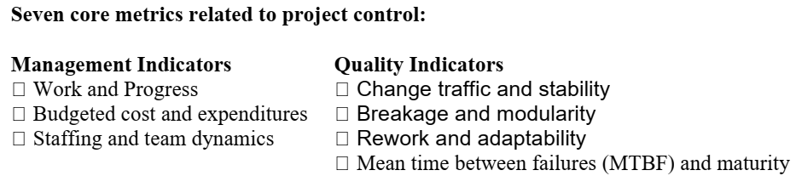
SEVEN CORE METRICS OF SOFTWARE PROJECT
Software metrics instrument the activities and products of the software development/integration process. Metrics values provide an important perspective for managing the process. The most useful metrics are extracted directly from the evolving artifacts. There are seven core metrics that are used in managing a modern process.

Slide 7
SEVEN CORE METRICS OF SOFTWARE PROJECT
MANAGEMENT INDICATORS:
Work and progress
This metric measure the work performed over time. Work is the effort to be accomplished to complete a certain set of tasks. The various activities of an iterative development project can be measured by defining a planned estimate of the work in an objective measure, then tracking progress (work completed overtime) against that plan.
The default perspectives of this metric are:
Software architecture team: - Use cases demonstrated.
Software development team: - SLOC under baseline change management, SCOs(software change order) closed
Software assessment team: - SCOs opened, test hours executed and evaluation criteria meet.
Software management team: - milestones completed.

Slide 8
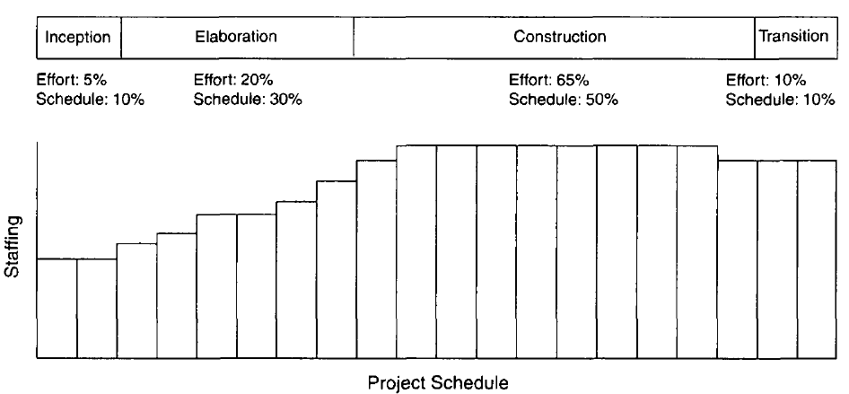
SEVEN CORE METRICS OF SOFTWARE PROJECT

Slide 9
SEVEN CORE METRICS OF SOFTWARE PROJECT
QUALITY INDICATORS:
Change traffic and stability:
This metric measures the change traffic over time.
The number of software change orders opened and closed over the life cycle is called change traffic.
Stability specifies the relationship between opened versus closed software change orders.
This metric can be collected by change type, by release, across all releases, by term, by components, by subsystems, etc.

Slide 10
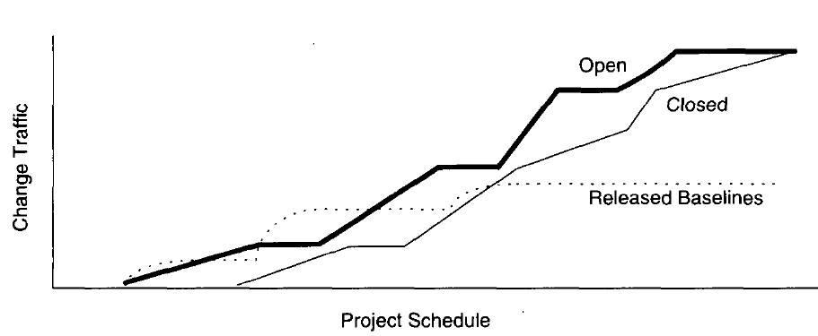
SEVEN CORE METRICS OF SOFTWARE PROJECT

Slide 11
SEVEN CORE METRICS OF SOFTWARE PROJECT
Breakage and modularity
This metric measures the average breakage per change over time.
Breakage is defined as the average extent of change, which is the amount of software baseline that needs rework and measured in source lines of code, function points, components, subsystems, files or other units.
Modularity is the average breakage trend over time.
This metric can be collected by revoke SLOC per change, by change type, by release, by components and by subsystems.

Slide 12
SEVEN CORE METRICS OF SOFTWARE PROJECT
Rework and adaptability:
This metric measures the average rework per change over time.
Rework is defined as the average cost of change which is the effort to analyse, resolve and retest all changes to software baselines.
Adaptability is defined as the rework trend over time.
This metric provides insight into rework measurement.
All changes are not created equal.
Some changes can be made in a staff- hour, while others take staff-weeks.
This metric can be collected by average hours per change, by change type, by release, by components and by subsystems.

Slide 13
SEVEN CORE METRICS OF SOFTWARE PROJECT
MTBF and Maturity:
This metric measures defect rather over time. MTBF (Mean Time Between Failures) is the average usage time between software faults.
It is computed by dividing the test hours by the number of type 0 and type 1 SCOs.
Maturity is defined as the MTBF trend over time.
Software errors can be categorized into two types deterministic and nondeterministic.

Slide 14
SEVEN CORE METRICS OF SOFTWARE PROJECT
MTBF and Maturity:
Deterministic errors are also known as Bohr-bugs and nondeterministic errors are also called as Heisen-bugs.
Bohr-bugs are a class of errors caused when the software is stimulated in a certain way such as coding errors.
Heisen-bugs are software faults that are coincidental with a certain probabilistic occurrence of a given situation, such as design errors.
This metric can be collected by failure counts, test hours until failure, by release, by components and by subsystems.
These four quality indicators are based primarily on the measurement of software change across evolving baselines of engineering data.

Slide 15
LIFE -CYCLE EXPECTATIONS
There is no mathematical or formal derivation for using seven core metrics properly. However, there were specific reasons for selecting them:
The quality indicators are derived from the evolving product rather than the artifacts.
They provide inside into the waste generated by the process. Scrap and rework metrics are a standard measurement perspective of most manufacturing processes.
They recognize the inherently dynamic nature of an iterative development process.
Rather than focus on the value, they explicitly concentrate on the trends or changes with respect to time.
The combination of insight from the current and the current trend provides tangible indicators for management action.

Slide 16
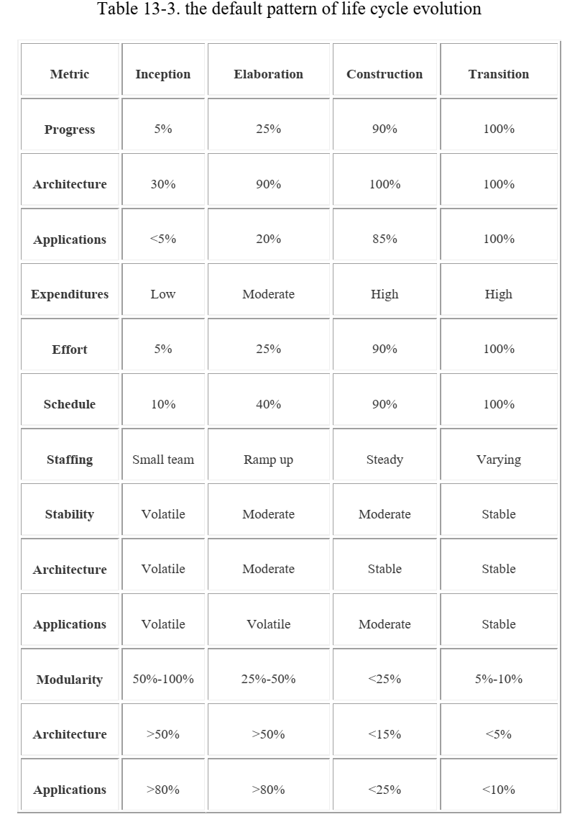
LIFE -CYCLE EXPECTATIONS

Slide 17
METRICS AUTOMATION
Many opportunities are available to automate the project control activities of a software project.
A Software Project Control Panel (SPCP) is essential for managing against a plan.
This panel integrates data from multiple sources to show the current status of some aspect of the project.
The panel can support standard features and provide extensive capability for detailed situation analysis.
SPCP is one example of metrics automation approach that collects, organizes and reports values and trends extracted directly from the evolving engineering artifacts.

Slide 18
METRICS AUTOMATION
SPCP:
To implement a complete SPCP, the following are necessary. Metrics primitives - trends, comparisons and progressions
A graphical user interface.
Metrics collection agents
Metrics data management server
Metrics definitions - actual metrics presentations for requirements progress, implementation progress, assessment progress, design progress and other progress dimensions.
Actors - monitor and administrator.

Slide 19
METRICS AUTOMATION
Monitor defines panel layouts, graphical objects and linkages to project data. Specific monitors called roles include software project managers, software development team leads, software architects and customers.
Administrator installs the system, defines new mechanisms, graphical objects and linkages.
The whole display is called a panel.
Within a panel are graphical objects, which are types of layouts such as dials and bar charts for information
Each graphical object displays a metric.

Slide 20
METRICS AUTOMATION
A panel contains a number of graphical objects positioned in a particular geometric layout.
A metric shown in a graphical object is labelled with the metric type, summary level and insurance name (line of code, subsystem, server1).
Metrics can be displayed in two modes – value, referring to a given point in time and graph referring to multiple and consecutive points in time.
Metrics can be displayed with or without control values. A control value is an existing expectation either absolute or relative that is used for comparison with a dynamically changing metric.
Thresholds are examples of control values.

Slide 21
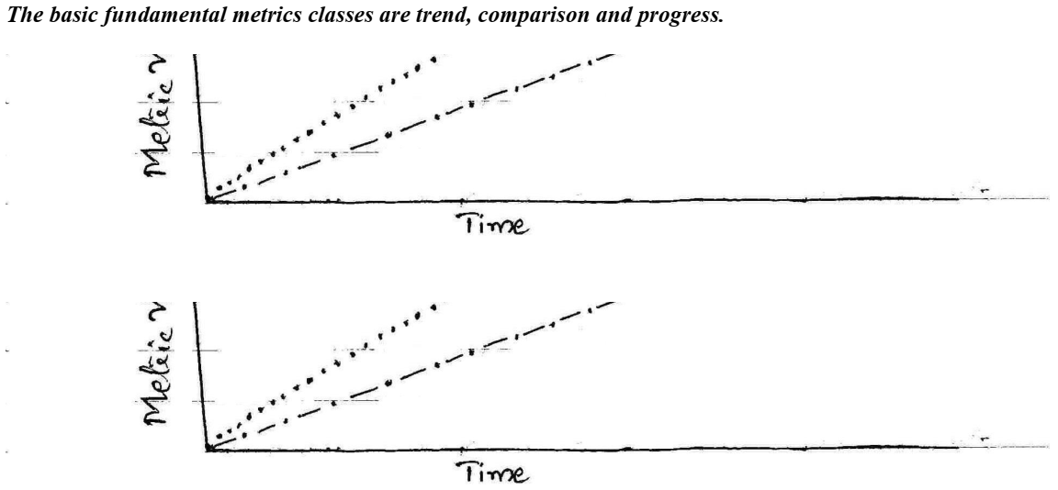
METRICS AUTOMATION

Slide 22
METRICS AUTOMATION
The format and content of any project panel are configurable
to the software project manager's preference for tracking
metrics of top-level interest. The basic operation of an SPCP
can be described by the following top –level use case.
i. Start the SPCP ii. Select a panel preference iii. Select a value or graph metric iv. Select to superimpose controls v. Drill down to trend vi. Drill down to point in time. vii. Drill down to lower levels of information viii. Drill down to lower level of indicators.

Slide 23
Pragmatic Software Metrics
Measuring is useful, but it doesn't do any thinking for the decision makers.
It only provides data to help them ask-tne right questions, understand the context, and make objective decisions.
Because of the highly dynamic nature of software projects, these measures must be available at any time, tailorable to various subsets of the evolving product (release, version, component, class), and maintained so that trends can be assessed (first and second derivatives with respect to time).
This situation has been achieved in practice only in projects where the metrics were maintained on-line as an automated by-product of the development/integration environment.

Slide 24
Pragmatic Software Metrics
The basic characteristics of a good metric are as follows:
It is considered meaningful by the customer, manager, and performer. If any one of these stakeholders does not see the metric as meaningful, it will not be used. "The customer is always right" is a sales motto, not an engineering tenet. Customers come to software engineering providers because the providers are more expert than they are at developing and managing software. Customers will accept metrics that are demonstrated to be meaningful to the developer,
2. It demonstrates quantifiable correlation between process perturbations and business performance. The only real organizational goals and objectives are financial: cost reduction, revenue increase, and margin increase.
3. It is objective and unambiguously defined. Objectivity should translate into some form of numeric representation (such as numbers, percentages, ratios) as opposed to textual representations (such as excellent, good, fair, poor). Ambiguity is minimized through well-understood units of measurement (such as staff-month, SLOC, change, function point, class, scenario, requirement), which are surprisingly hard to define precisely in the software engineering world.

Slide 25
Pragmatic Software Metrics
The basic characteristics of a good metric are as follows:
4. It displays trends. This is an important characteristic. Understanding the change in a metric's value with respect to time, subsequent projects, subsequent releases, and so forth is an extremely important perspective, especially for today's iterative development models. It is very rare that a given metric drives the appropriate action directly. More typically, a metric presents a perspective. It is up to the decision authority (manager, team, or other information processing entity) to interpret the metric and decide what action is necessary.
5. It is a natural by-product of the process. The metric does not introduce new artifacts or overhead activities; it is derived directly from the mainstream engineering and management workflows.
6. It is supported by automation. Experience has demonstrated that the most successful metrics are those that are collected and reported by automated tools, in part because software tools require rigorous definitions of the data they process.

Slide 26
Pragmatic Software Metrics
When metrics expose a problem, it is important to get underneath all the symptoms and diagnose it. Metrics usually display effects; the causes require synthesis of multiple perspectives and reasoning. For example, reasoning is still required to interpret the following situations correctly:
A low number of change requests to a software baseline may mean that the software is mature and error-free, or it may mean that the test team is on vacation.
A software change order that has been open for a long time may mean that the problem was simple to diagnose and the solution required substantial rework, or it may mean that a problem was very time-consuming to diagnose and the solution required a simple change to a single line of code.
A large increase in personnel in a given month may cause progress to increase proportionally if they are trained people who are productive from the outset. It may cause progress to decelerate if they are untrained new hires who demand extensive support from productive people to get up to speed.
Value judgments cannot be made by metrics; they must be left to smarter entities such as software project managers.

Slide 27
Tailoring the Process
Software management efforts span a broad range of domains. While there are some universal themes and techniques, it is always necessary to tailor the process to the specific needs of the project at hand.
A commercial software tool developer with complete control of its investment profile will use a very different process from that of a software integrator on contract to automate the security system for a nuclear power plant.
There is no doubt that a mature process and effective software management approaches offer much greater value to the large-scale software integrator than they do to the small-scale tool developer.
Nevertheless, relative to their business goals, the return on investment realized by better software management approaches is worthwhile for any software organization.

Slide 28
Tailoring the Process
Software management efforts span a broad range of domains. While there are some universal themes and techniques, it is always necessary to tailor the process to the specific needs of the project at hand.
A commercial software tool developer with complete control of its investment profile will use a very different process from that of a software integrator on contract to automate the security system for a nuclear power plant.
There is no doubt that a mature process and effective software management approaches offer much greater value to the large-scale software integrator than they do to the small-scale tool developer.
Nevertheless, relative to their business goals, the return on investment realized by better software management approaches is worthwhile for any software organization.

Slide 29
Tailoring the Process
Build a Framework First
A common problem for many projects is that they often focus heavily in one particular area, to the extent that they get bogged down with the details of that particular area before making sure that they have a good idea of what "key" elements are involved in the whole process lifecycle of producing a quality product. It's usually better to address all key elements of a process in a lightweight manner before focusing heavily on any one particular problem area.
Once the framework for a quality software process is in place, a project can effectively focus on a particular area that has been identified as a major contributor to their problems. This selection is based on identifying and prioritizing risks to the project, and determining early mitigation strategies for those identified risks.
Do not include activities and artifacts that cannot be clearly justified
The well-intentioned project manager or process engineer may have a large wish list of nice-to-have metrics, controls, reports, and so on. However, activities and artifacts cost time and money. Some of these costs, such as daily interaction with the environment toolset, may or may not be visible, but simply get folded into lower productivity on standard tasks.
You must distinguish critical process needs from the wish list and determine whether the benefits outweigh the cost.

Slide 30
Tailoring the Process
Shield your developers from the process
You probably have highly trained staff with valuable skills in designing, implementing, and testing. Don't have them spend hours each week filling out forms, enhancing documentation, or fighting with unwieldy tools. If these activities are required, consider having them done by qualified support staff.
Minimize formal intermediate artifacts
The format of intermediate artifacts—those artifacts not intended for the final product—is not as important as the activity and thought needed to produce them. It doesn't matter what they look like, or what tools you use to build them, provided they serve their purpose. As Dwight D. Eisenhower said, “The plan is nothing; the planning is everything.”
One trap that's easy to fall into is formalizing artifacts far too soon. Early versions of artifacts often evolve quickly and remain fluid for some time as different representations while their implications are explored. Formal documentation can impede this process; you can waste a lot of time polishing an artifact that's largely expendable. Hand-drawn diagrams and simple descriptions on index cards are often sufficient in the early stages of an artifact and, for some projects, may be all that's required.
Use Convenient Formats
An artifact may be tailored so it can be maintained in any form. For example, the Vision document may be captured as a Web page, the Project Plan may be captured as a Microsoft Project file, and the Risk List may be captured as a Rational Requisite Pro requirement type.

Slide 31
Tailoring the Process
Generate when possible
Some projects spend a lot of time populating templates of formal documents by manually cutting and pasting information. Instead, consider generating required documents from the source, using tools such as Rational SoDA, or negotiate a simpler way of providing the same information, such as using Rational Rose Publisher to generate a Web-based design model.
In many cases, you can skip an artifact altogether because the information is implicitly provided in the environment. For example, rather than generate the section of the Requirements Management Plan that lists attributes of requirements types, you may want to only provide the tailored Rational Requisite Pro project with the applicable requirements types and traceability, and then walk through it with the interested parties. Another example is to provide a read-only version of the Microsoft Project files to the interested parties, rather than duplicating graphics into a separate Software Development Plan.
Use the Web
A useful artifact is one that communicates valuable information. This information should be at the fingertips of those who need it. Web technology is an excellent mechanism for this purpose. If the requirements, design, and implementation are available on the Web, there's no need to generate large sets of quickly obsolesced paper documentation.

Slide 32
Tailoring the Process
Use integrated tools
Select tools that fit the process and tailor the process to fit the tools. The desired results are an easy-to-use process and toolset. Integrated tools generally provide greater consistency, and more informative metrics and reports than tools that are not integrated.
Regularly Revisit the Process
Regularly revisit the process to refine and reduce its complexity. If your staff isn't convinced that each step in the process provides added value for the end product, then the process is probably broken.
Tailor while retaining best practices
The RUP encourages tailoring. However, tailoring is not a license to bypass the process altogether. The essentials of the RUP are embodied in its best practices. Follow the spirit of these best practices when tailoring the activities and artifacts to fit your needs.

Slide 33
Process Discriminant
In tailoring the management process to a specific domain or project, there are two dimensions of discriminating factors: technical complexity and management complexity.
Illustrates these two dimensions of process variability and shows some example project applications.
The formality of reviews, the quality control of artifacts, the priorities of concerns, and numerous other process instantiation parameters are governed by the point a project occupies in these two dimensions.

Slide 34
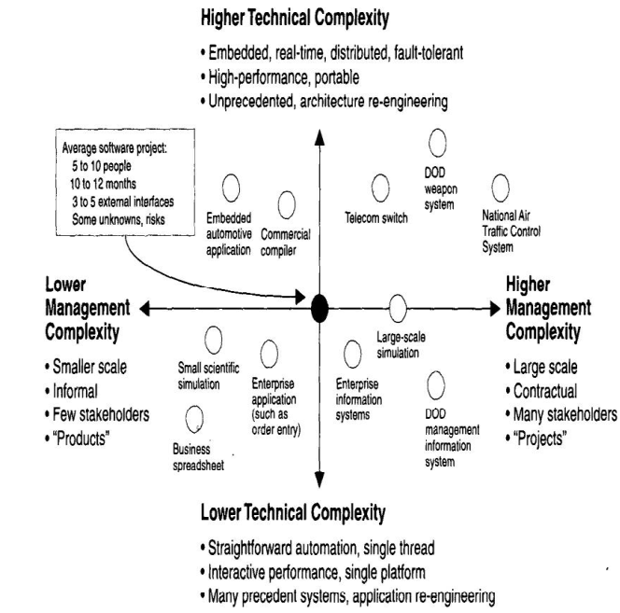
Process Discriminant

Slide 35
Process Discriminant
A process framework is not a project-specific process implementation with a well-defined recipe for success.
Judgment must be injected, and the methods, techniques, culture, formality, and organization must be tailored to the specific domain to achieve a process implementation that can succeed.
The following discussion about the major differences among project processes is organized around six process parameters: the size of the project and the five parameters that affect the process exponent, and hence economies of scale, in COCOMO II.
These are some of the critical dimensions that a software project manager must consider when tailoring a process framework to create a practical process implementation.

Slide 36
Modern project management
Modern project management serves unique projects.
These could be one-time projects, such as website builds.
Often, a services provider specializes in delivering unique projects repeatedly, such as a creative website builder.
Because of its customized results, modern project management requires more flexible processes and scopes as well as highly specialized resources.
It’s common to find services firms tapping outside resources through contract tasks that roll up into a larger project within the provider’s core services offering.

Slide 37
Modern project management
What does that mean for PLOC?
In modern project management, there have been several shifts related to planning, leading, organizing, and controlling work.
1. Plan
Project planning has become more flexible. Once a deal closes, project managers must find the appropriate resources, budget, timeframe, and tools (i.e., technology) required to complete the work in a timely manner and for a cost to which the client has agreed.

Slide 38
Modern project management
2. Lead
Today’s project managers need a more widespread understanding of specific resource skills, since they will be leading a variety of people through specialized tasks that roll-up into the successful deliverable. They must speak many languages, from programming and creative to project financials, sales, and accounting. This knowledge helps them gain group consensus, solicit specific contributions, and create the best environment for individuals to contribute to the group project.
3. Organize
Organization requires greater flexibility as well. Project managers are increasingly relying on technology to help conduct their work. They are looking for solutions that pull them out of time-consuming spreadsheet calculations, data exports, manual report building, and manual monitoring in favor of real-time integrations and tracking tools now available. This helps them optimize resource allocation, budget tracking, report building, and on-time delivery.

Slide 39
Modern project management
4. Control
With more flexible tools comes greater control.
Project managers are able to shift resources mid-project in order to address an issue that has arisen, such as potentially not meeting a deadline or going over budget.
Today’s software creates this environment of greater control, with early adopters of platform innovations pulling ahead of their competitors.

Slide 40
Next-Generation Software Economics
Software engineering is dominated by intellectual activities focused on solving problems with immense complexity and numerous unknowns in competing perspectives.
The early software approaches of the 1960s and 1970s can best be described as craftsmanship, with each project using a custom process and custom tools. In the 1980s and 1990s, the software industry matured and transitioned to more of an engineering discipline.
However, most software projects in this era were still primarily research-intensive, dominated by human creativity and diseconomies of scale.
The next generation of software processes is driving toward a more production-intensive approach dominated by automation and economies of scale.
Next-generation software economics are already being achieved by some advanced software organizations. Many of the techniques, processes, and methods described in a modern process framework have been practiced for several years. However, a mature, modern process is nowhere near the state of the practice for the average software organization.

Slide 41
Next-Generation Software Economics
Finding and fixing a software problem after delivery costs 100 times more than finding and fixing the problem in early design phases.
This metric dominates the rationale for most software process improvement.
Modern processes, component-based development technologies, and architecture frameworks are explicitly targeted at improving this relationship.
An architecture-first approach will likely yield ten-fold to hundred-fold improvements in the resolution of architectural errors.
Consequently, a modern process places a huge premium on early architecture insight and risk-confronting activities.

Slide 42
Next-Generation Software Economics
You can compress software development schedules 25% of nominal, but no
more.
An N% reduction in schedule would require an M% increase in personnel resources (assuming that other parameters remain fixed). Any increase in people requires more management overhead.
In general, the limit of flexibility in this overhead, along with scheduling concurrent activities, conserving sequential activities, and other resource constraints, is about 25%.
This metric should remain valid for the engineering stage of the life cycle, where the intellectual content of the system is evolved.
However, if the engineering stage is successful at achieving a consistent baseline, including architecture, construction plans, and feature scope, schedule compression in the production stage should be more flexible.
Whether a line-of-business organization is amortizing the engineering stage across multiple projects, or a project organization is amortizing the engineering stage across multiple increments, there should be much more opportunity for concurrent development.

Slide 43
Next-Generation Software Economics
For every $1 you spend on development, you will spend
$2 on maintenance.
Anyone working in the software industry over the past 10 to 20 years knows that most of the software in operation is considered to be difficult to maintain.
A better way to measure this ratio would be the productivity rates between development and maintenance.
One interesting aspect of iterative development is that the line between development and maintenance has become much fuzzier.
There is no doubt that a mature iterative process and a good architecture can reduce scrap and rework levels considerably.

Slide 44
Next-Generation Software Economics
Software development and maintenance costs are primarily a function of the number of source lines of code.
This metric is primarily due to the predominance of custom software development, lack of commercial components, and lack of reuse inherent in the era of the conventional process, in which the size of the product was the primary cost driver and the fundamental unit of size was a line of code.
Commercial components, reuse, and automatic code generators can seriously pollute the meaning of a source line of code. Construction costs will still be driven by the complexity of the bill of materials.
More components, more types of components, more sources of components, and more custom components will result in more integration labor and drive up costs.
Fewer components, fewer types, fewer sources, and more industrial-strength tooling will drive down costs. Next-generation cost models should become less sensitive to the number of source lines and more sensitive to the discrete numbers of components and their ease of integration.

Slide 45
Next-Generation Software Economics
The overall ratio of software to hardware costs is still growing. In
1955 it was 15:85; in 1985, 85:15.
The need for software, its breadth of applications, and its complexity continue to grow almost without limits.
The main impact of this metric on software economics is that hardware continues to get cheaper. Processing cycles, storage, and network bandwidth continue to offer new opportunities for automation.
Consequently, software environments are playing a much more important role.
From a modern process perspective, I can see the environment doing much more of the bookkeeping and analysis activities that were previously done by humans.
Configuration control and quality assurance analyses are already largely automated, and the next frontier is probably significant improvements in automated production and automated testing.

Slide 46
Next-Generation Software Economics
Only about 15% of software development effort is
devoted to programming.
The amount of programming that goes on in a software development project is probably still roughly 15%.
The difference is that modern projects are programming at a much higher level of abstraction.
An average staff-month of programming produced maybe 200 machine instructions in the 1960s and 1000 machine instructions in the 1970s and 1980s.
Programmer productivity in the 1990s can produce tens of thousands of machine instructions in a single month, even though only a few hundred human-generated source lines may be produced.

Slide 47
Next-Generation Software Economics
Software systems and products typically cost three
times as much per instruction as individual software
programs.
Software-system products (i.e., system of systems) cost nine times as much.
This exponential relationship is the essence of what is called "diseconomy of scale." Unlike other commodities, the more software you build, the more expensive per unit item it is.
This diseconomy of scale should be greatly relieved with a modern process and modern technologies.
Under certain circumstances, such as a software line of business producing discrete, customer-specific software systems with a common architecture, common environment, and common process, an economy of scale should be achievable.

Slide 48
Next-Generation Software Economics
Walkthroughs catch 60% of the errors.
This may be true, but walkthroughs are not catching the errors that matter.
All defects are not created equal. In general, walkthroughs and other forms of human inspection are good at catching surface issues and style issues; few humans are good at reviewing even first-order semantic issues in a code or model segment.
How many programmers get their code to compile the first time? Human inspections and walkthroughs will not expose the significant issues (resource contention, performance bottlenecks, control conflicts, and the like); they will only help resolve them.
While the environment catches most of the first-level inconsistencies and errors, the really important architectural issues can only be exposed through demonstration and early testing and resolved through human scrutiny.

Slide 49
Next-Generation Software Economics
80% of the contribution comes from 20% of the
contributors.
This is true across almost any engineering discipline. These are the fundamental postulates that underlie the rationale for a modern software management process framework.
80% of the engineering is consumed by 20% of the requirements. 80% of the software cost is consumed by 20% of the components.
80% of software scrap and rework is caused by 20% of the errors.
80% of the resources are consumed by 20% of the components.
80% of the progress is made by 20% of the people. These relationships are timeless and constitute the background philosophy to be applied throughout the planning and conduct of a modern software management process.

Slide 50
Modern Process Transitions
Successful software management is hard work. Technical breakthroughs, process breakthroughs, and new tools will make it easier, but management discipline will continue to be the crux of software project success.
New technological advances will be accompanied by new opportunities for software applications, new dimensions of complexity, new avenues of automation, and new customers with different priorities.
Accommodating these changes will perturb many of our ingrained software management values and priorities. However, striking a balance among requirements, designs, and plans will remain the underlying objective of future software management endeavors, just as it is today.

Slide 51
Modern Process Transitions
The software management framework I have presented in this book is not revolutionary; numerous projects have been practicing some of these disciplines for years.
However, many of the techniques and disciplines suggested herein will necessitate a significant paradigm shift. Some of these changes will be resisted by certain stakeholders or by certain factions within a project or organization.
It is not always easy to separate cultural resistance from objective resistance..

Slide 52
Modern Process Transitions
The transition to modern software processes and technologies necessitates to several culture shifts that will not ; always be easy to achieve.
Lessons learned in transitioning organizations to a modern process have exposed several recurring themes of success that represent important culture shifts from conventional practice.
A significant transition should be attempted on a significant project. Pilot to projects do not generally attract top talent, and top talent is crucial to the success of any significant transition.

